Slide 1
Using mathematical modeling to inform voluntary male medical circumcision (VMMC) policy
Michel Tchuenche, PhD
Senior Health Specialist
Project SOAR/Avenir Health
10th IAS Conference on HIV Science (IAS 2019)
SOAR IAS satellite on research utilization
Mexico City, Mexico
21-24 JULY 2019

Slide 2
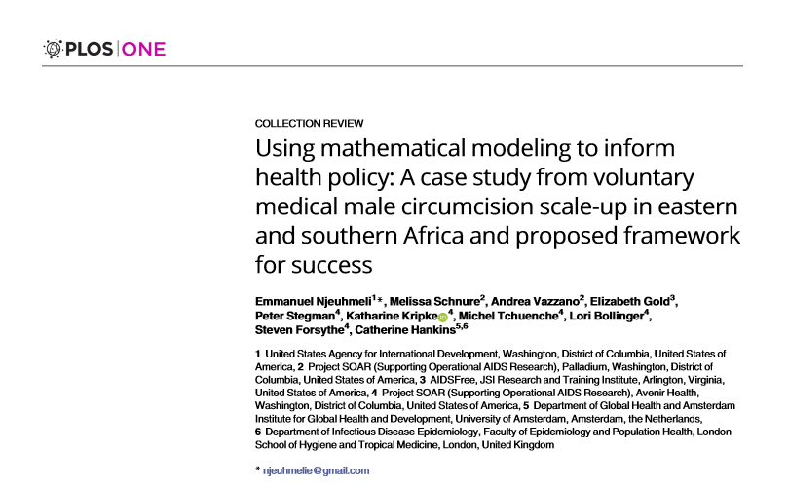
Background
Mathematical modeling is a key tool when direct evaluation of health interventions is not an option
More viable and timely when quick decision-making is needed
Modeling results are often not easily translated into practical policies
Notes:
https://doi.org/10.1371/journal.pone.0213605
Planning a country’s response to HIV is a complex decision-making process
Mathematical modeling has proven to be a critical tool in tailoring the national VMMC program to maximize impact while maintaining programmatic feasibility
But there has historically been a disconnect between modelers and policymakers
----
A series of exercises demonstrates how modelers can create tools that effectively support policy decisions.
Lessons learned from the DMPPT are presented to help think through how modelers and policymakers can bridge this gap: What needs to be considered/done to succeed?

Slide 3
Challenge: Moving from a theoretical model to policy
Need data, viable methodology, time, resources
Need simplicity, replicability, effectiveness, support
Modelers
Policymakers
Disconnect between modelers and policymakers can make it difficult to translate model results to policy
Communication (‘translation gap’)
Notes:
As mentioned, historically there has been a disconnect in communication between policymakers and modellers.
Modelers want to promote visibility of their models, but often face 2 problems
They create a model, but it does not address a question of interest/relevance to countries
Or they address a question of interest, but they have not validated assumptions and findings (therefore no one in country will agree with or use the results)
Policymakers
Many countries use very simple M&E tools, and when questions become too complex (e.g., how much investment is needed to achieve x level of coverage?) they give up.
Skepticism of models among those who don’t know the full context
May not be comfortable with data. Models could provide a very good opportunity to summarize very complex information in 1 or 2 numbers, but the assumptions the models use may make policymakers nervous.

Slide 4
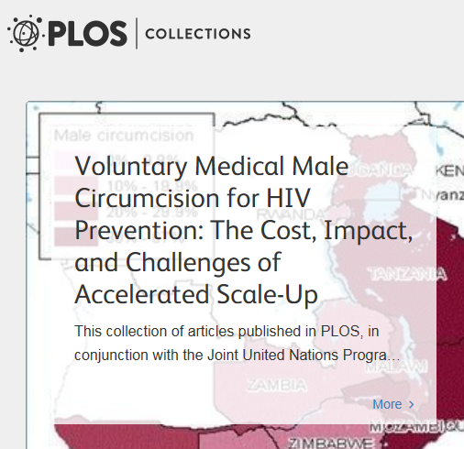
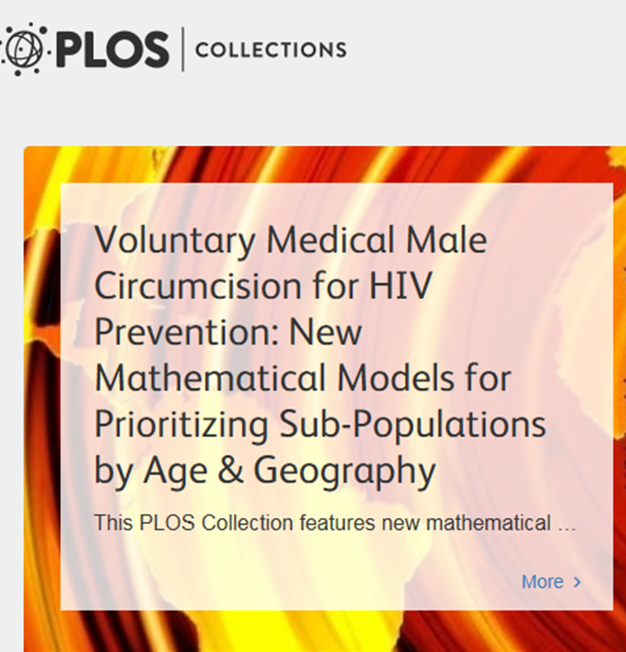
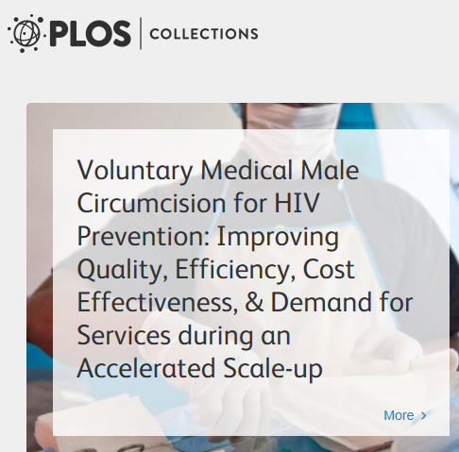
Evolution of the Decision Makers’ Program Planning Toolkit, Version 2 (DMPPT 2)
Model iterations demonstrated its wide-ranging potential and use
Tool for advocacy—Impact and cost of scaling-up VMMC
Strategic planning—Model customized by 5-year age bands and geography
Program monitoring—Online user-friendly
Its success can serve as a blueprint for others looking to apply modeling to inform policy
Advocacy
- Desk exercise in 2011
- Public data from 13 countries
Strategic Planning
- Applications in 9 countries
- Stakeholder engagement
- Customized to each country
Monitoring
- Simplified, web-based version
- Accessible data: VMMC targets, coverage, and impact projections
DMPPT
DMPPT 2
DMPPT 2
Online
http://collections.plos.org/s/vmmc
Notes:
Series of VMMC modeling exercises has had a significant impact on global VMMC policies
Three rounds of DMPPT modeling:
First, DMPPT developed in 2007 at the request of UNAIDS after the recommendation to include VMMC as a priority HIV prevention intervention – largely a desk exercise (between 2009 and 2011), done for global advocacy to demonstrate important of VMMC scale-up for HIV prevention; published in a PLOS collection in 2011
Impact and cost of scaling-up VMMC
As a result, most countries agreed to scale-up VMMC
Second, DMPPT 2 – country applications (feedback from first round was that it was not country-specific enough) with significant stakeholder engagement; allowed for customization by age group and geography
Used more for strategic planning than advocacy
9 countries; additional PLOS collection in 2016 (country applications in Malawi, South Africa, Eswatini, Tanzania, Uganda); next applications: Kenya, Lesotho, Mozambique, Namibia
Third, DMPPT 2 Online – point was to make something user-friendly (previous round was a complex, Excel-based model that could only be modified at headquarters); allows users to play around with scenarios; now goes down to the district-level (or other SNU based on country)
Purpose: for monitoring of programs

Slide 5
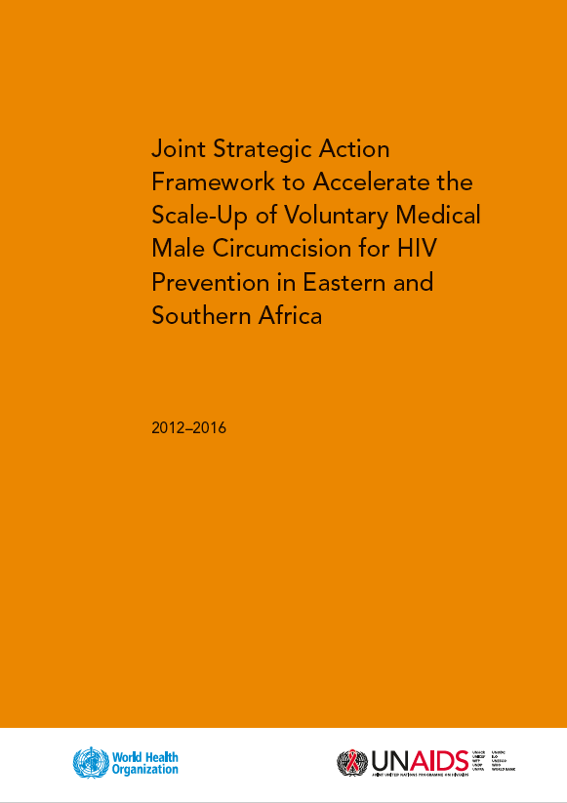
Success: Results from first model iteration
DMPPT: Microsoft Excel-based modeling tool populated with publicly-available data (2011)
Showed VMMC scale-up would result in substantial reductions in HIV infections and lower health system costs
Outcome (How was the modeling used?)
An 80% coverage target was incorporated into the WHO-UNAIDS Joint Strategic Action Framework for VMMC (Dec 2011)
All VMMC priority countries included VMMC scale-up in their national strategic plans
PEPFAR significantly increased its VMMC budget.
Notes:
First time: Desk Exercise DMPPT
In 2011 a Microsoft-Excel-based modeling tool, populated with publicly-available data, demonstrated that VMMC scale-up would result in substantial reductions in HIV infection and lower health system costs.
The results showed that VMMC scale-up to 80% male circumcision coverage among men ages 15-49 would result in substantial reductions in HIV infections and savings in treatment costs averted.
As a result:
the 80% target was incorporated into the WHO-UNAIDS Joint Strategic Action Framework for VMMC in December 2011
all countries included VMMC scale-up in their national strategic plans,
and PEPFAR significantly increased its VMMC budget.
The first modeling exercise was a desk review. Countries were consulted by phone. Data were yet to be validated in countries.
It helped to advocate for the general need
But a lot of the criticism was that it wasn’t country-specific.
Reason why the second application of the model was country specific.

Slide 6
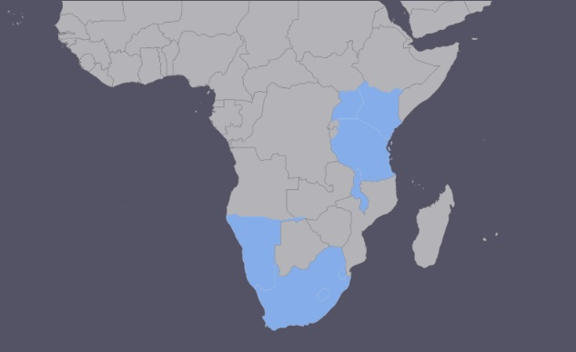
DMPPT 2: Country engagement for strategic planning
DMPPT 2 implementation (2015/16)— Avenir Health
Coordinated with “global” stakeholders and shared results and slide sets
Country-specific model applications
Worked closely with VMMC in-country stakeholders in Malawi, South Africa, Eswatini, Tanzania, Uganda, Kenya, Namibia, Lesotho, and Mozambique
Customized model inputs/analyses based on stakeholders’ inputs and needs.
Nine VMMC priority countries incorporated outputs from the DMPPT 2 modeling exercise into their program planning
Notes:
A second model (DMPPT 2) was created to enable analyses of impact and cost-effectiveness by age group and subnational region starting in 2013.
Emphasis on in-country engagement from start to finish.

Slide 7
Example: Application of the DMPPT 2 in Eswatini
In 2013/2014, Eswatini MOH wanted to better align VMMC targets with varying demand among different age groups
After examining the results of six modeling scenarios, MOH opted for 50% coverage scale up for neonates, 80% among males ages 10-29, and 55% for 30-34.
These evidence-based targets were incorporated into the Male Circumcision Strategic and Operational Plan for HIV Prevention, 2014–2018.
“[Our] plan was chosen with the intention of balancing cost, cost-effectiveness, impact, and programmatic feasibility.”
- Dr Simon M. Zwane, Principal Secretary of Eswatini’s Ministry of Health

Slide 8
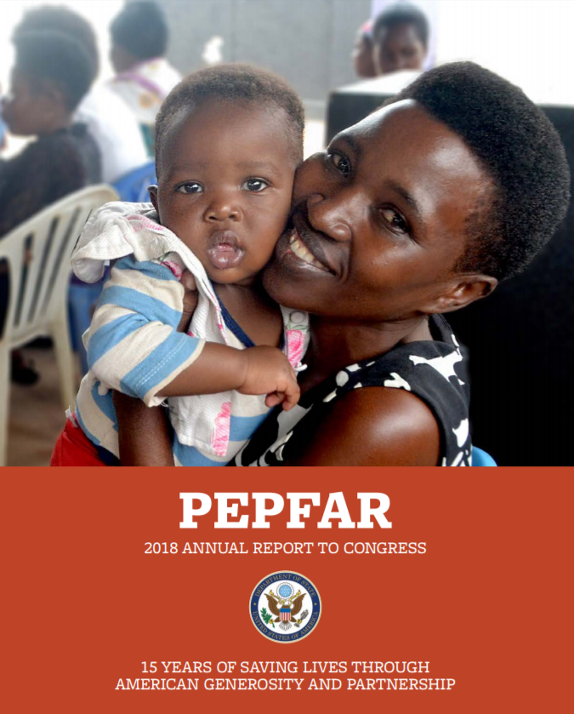
Example: Application of the DMPPT 2 in Mozambique
The DMPPT 2 helps program planners in Mozambique identify and prioritize scale-up in specific geographic areas
Two provinces, Manica and Tete with the least progress in reaching 80% VMMC coverage and highest unmet need in FY14 were prioritized
Site-level inefficiencies were identified using a new tool: the Site Capacity and Productivity assessment Tool (SCPT) http://www.vmmscpt.org/
“We continue to realign and refocus the program in every country where we work, employing better data and business practices to save more lives, prevent more infections, and have the largest impact on the epidemic.”
- PEPFAR 2018 annual report

Slide 9
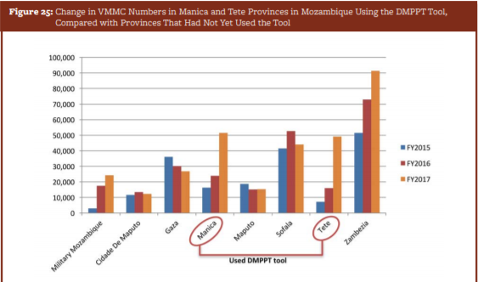
Example: Application of the SCPT in Mozambique
“…a PEPFAR funded tool was shown to effectively optimize site utilization in Mozambique, matching demand for VMMC with staff capacity. Paired with Geographic Information System mapping, this tool led to marked increases in VMMC in the provinces where it was used.”
—Page 66 https://www.pepfar.gov/documents/organization/279889.pdf

Slide 10
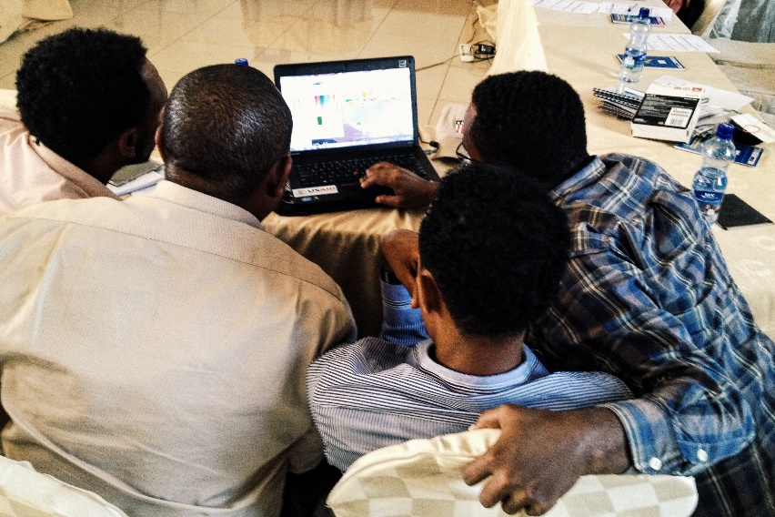
Conclusion: Facilitators for translating evidence into policy and practice
Engage Stakeholders early and often
Design a simple-to-use interface with user guide
http://dmppt2.org/
http://www.vmmscpt.org/
Get to know the policymaking process: Tailored results to users’ need (e.g., to feed into national strategic plan)
COP planning—USG and country staff/program planners need to estimate
Current MC coverage at national, provincial and district level by 5-year age bands
Numbers of circumcisions needed to reach the desired age-specific MC coverage within the specific time period
Plan for sustainability
Regular refresher trainings and updates
Facilitate dialogue around tool integration into policy-makers’ process
Notes:
Lessons learned:
Engage Stakeholders early and often
Get to know the policymaking process
Plan for sustainability

Slide 11
Recommendation: Proposed framework for success
Stakeholder Engagement Best Practices
Identify and engage a wide array of stakeholders involved with the program (local, national and global levels)
Ensure an understanding of the value of modeling (“sell” stakeholders on your model)
Identify/agree on the research question
Identify/agree on the input variables
Identify/agree on assumptions
After completing the model analysis, come together to review results and agree on policy implications
Find an in-country influencer/champion
Engage the right stakeholders early and often
Encourage consensus throughout to ensure ownership later
Customize analyses to reflect specific realities of each country (use stakeholder input)
Create user-friendly tools to put power in the hands of program managers
Establish a plan for sustainability
Notes:
Find influencer/champion
Need to identify the “ringleaders” to gather everyone.
Advocate: “Sell” modelling
You need to sell them a product. They need to understand what the product is.
People need data, but not everyone is comfortable with data. The modelling gives a very good opportunity to condense complex information in terms of 1 or 2 numbers.
Engage stakeholders early and often
This is time consuming. Takes back and forth between you and the stakeholders.
In-country champion must shepherd the process and ensure that the right stakeholders are engaged in the right way.
Takes variable time between countries, it depends. When people know data, the conversation moves fast. When people know what you are trying to do.
Require time in-country, this is not optional! Face time is crucial for the success of the exercise.
Encourage consensus throughout to ensure ownership later
Stakeholders need to be able to agree on almost every single step in the process
Tip is not to jump from one step to another without everyone agreeing
Allow for flexibility
Analyses must be customized to reflect on-the-ground realities of each country
Create user-friendly modeling tools
User-friendly tools can put power in the hands of program managers so that they don’t require continued in-depth support from the modeling team
Encourage discussion around sustainability
To use models as monitoring tools, they should ideally be updated every 2-3 years. Facilitate dialogue around how to best ensure that a model continues to be updated and used.

